Slide 1
Hospital Management System
Class & Collaboration Diagram
Presentation Presented by : Group 5
Student ID:1005011
1005016
1005019
1005021
1005024

Slide 2
Outline of the presentation
Subsystems
Class Diagrams(use-case wise)
Collaboration Diagrams(use-case wise)

Slide 3
Subsystems
Registration
Patient Management
Employee Management
Scheduling
Billing

Slide 4
1. Registration System
Use-Case Glossary:
Use-case ID>Name | Description | Participant Actors and roles
1.1>Register Patient | PT completes the registration process by giving necessary information to RCP | PT,RCP
1.2>Prepare Current Patient List | AD will prepare the current patient list | AD
1.3>View Current Patient List | RCP,AD can see the current patient list | RCP,AD

Slide 5
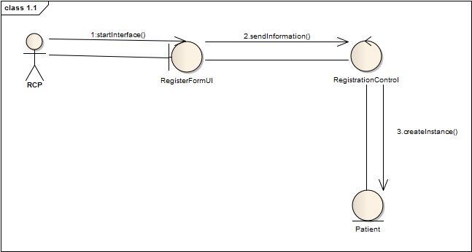
Use-case 1.1: Register Patient
Fig: Collaboration Diagram

Slide 6
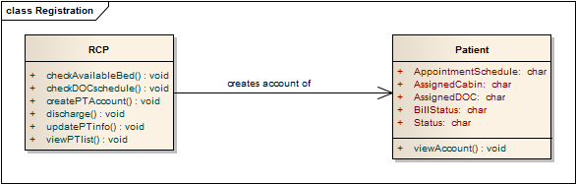
Use-case 1.1: Register Patient
Fig: Class Diagram

Slide 7
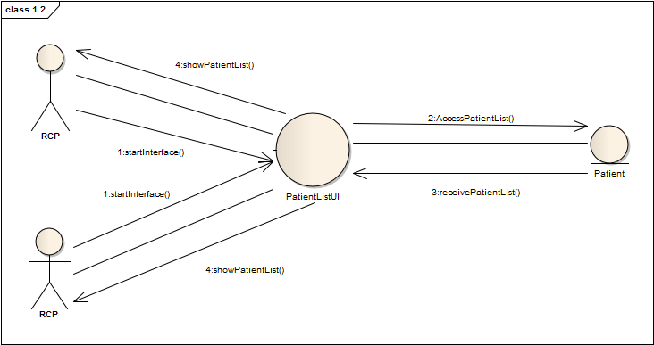
Use-case 1.2: Prepare Current Patient List
Fig: Collaboration Diagram

Slide 8
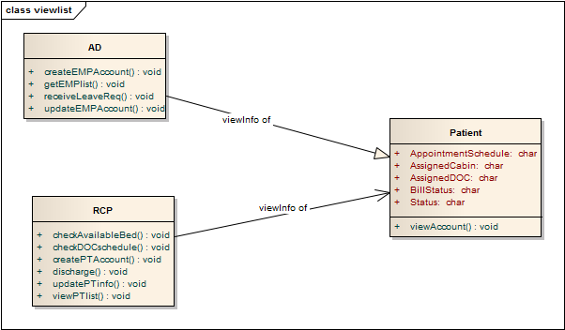
Use-case 1.2: Prepare Current Patient List
Fig: Class Diagram

Slide 9
2.Patient Management
Use-Case Glossary:
Use-case ID>Name | Description | Participant Actors and roles
2.1>Appointment Assign | PT goes to RCP and requests for an appointment, RCP checks the duty schedule of the DOC and makes an appointment | DOC,RCP,PT
2.2>Prepare Prescription | DOC will prepare electronic prescription | DOC
2.3>Update Patient Database | DEM will update the patient database by updating prescription and diagnostic information | DEM
2.4>Cabin/Bed Assign | PT requests for cabin/bed to RCP,RCP contacts with the AD and assigns a bed/cabin | PT,RCP,AD
2.5>Discharge | DOC, CLK permits the PT to be discharged | PT,DOC,CLK

Slide 10
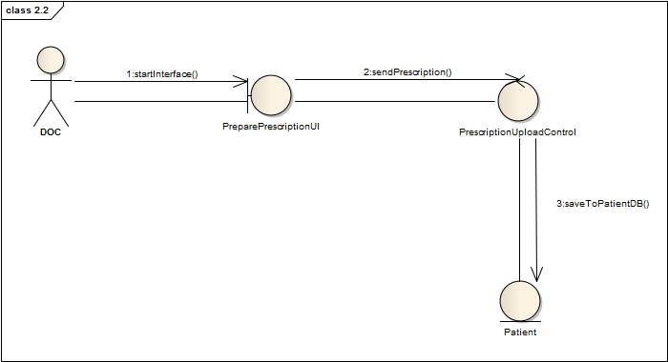
Use-case 2.2: Prepare Prescription
Fig: Collaboration Diagram

Slide 11
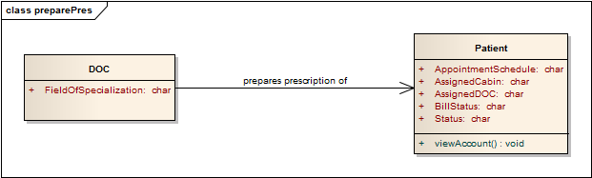
Use-case 2.2: Prepare Prescription
Fig: Class Diagram

Slide 12
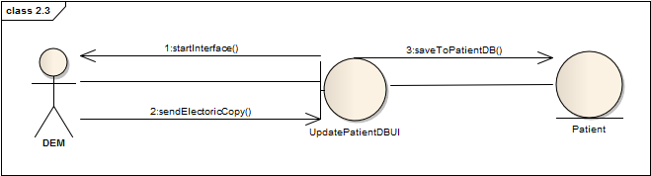
Use-case 2.3: Update Patient Database
Fig: Collaboration Diagram

Slide 13
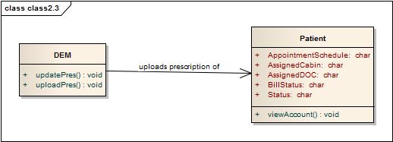
Use-case 2.3: Update Patient Database
Fig: Class Diagram

Slide 14
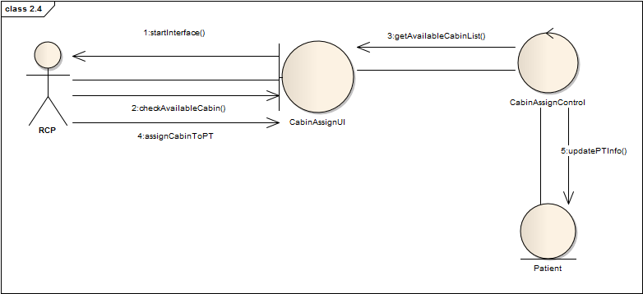
Use-case 2.4: Cabin/Bed Assign
Fig: Collaboration Diagram

Slide 15
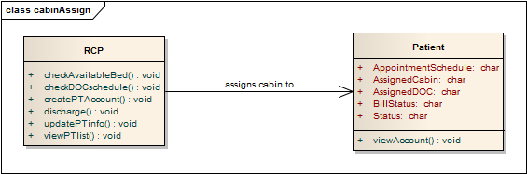
Use-case 2.4: Cabin/Bed Assign
Fig: Class Diagram

Slide 16
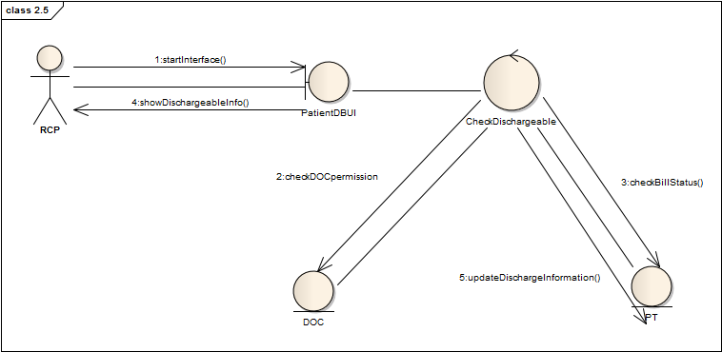
Use-case 2.5:Discharge
Fig: Collaboration Diagram

Slide 17
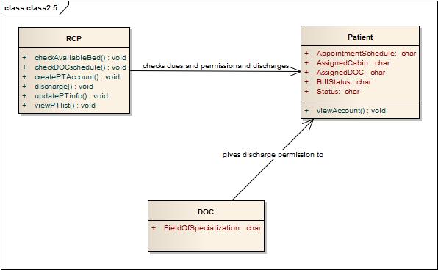
Use-case 2.5:Discharge
Fig: Class Diagram

Slide 18
3. Employee Management
Use-Case Glossary:
Use-case ID>Name | Description | Participant Actors and roles
3.1> Employee Profile Creation | AD creates new employee profile for each employee in the hospital | AD,EMP
3.2>Receive and Distribute Duty Schedule | HRO gets the duty schedule from 6.2 and gives it to the EMP | HRO
3.3>View Employee List | AD can view the employee list | AD
3.4>Update Employee Profile | AD can update employee profile, AD can also fire an employee, AD changes the pay scale salary | AD,EMP
3.5> Leave Management | EMP applies for leave , AD grants/denies the request and send it back to Scheduling Subsystem | AD,EMP

Slide 19
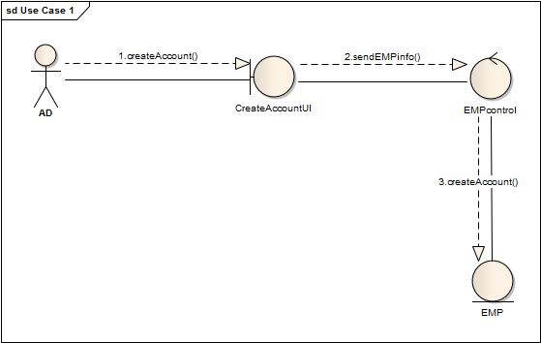
Use-case 3.1 : Employee Profile Creation
Fig: Collaboration Diagram

Slide 20
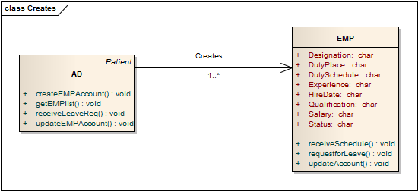
Use-case 3.1 : Employee Profile Creation
Fig: Class Diagram

Slide 21
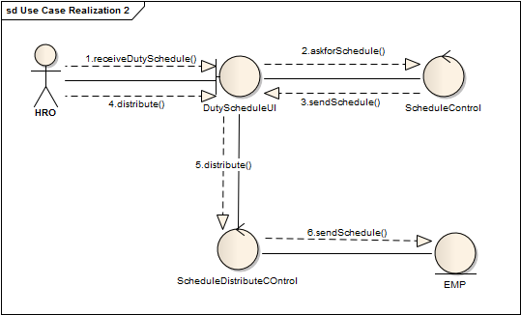
Use-case 3.2: Receive and Distribute Duty Schedule
Fig: Collaboration Diagram

Slide 22
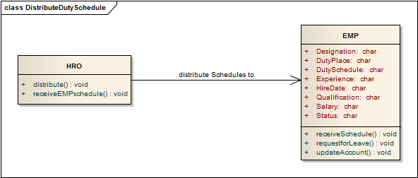
Use-case 3.2: Receive and Distribute Duty Schedule
Fig: Class Diagram

Slide 23
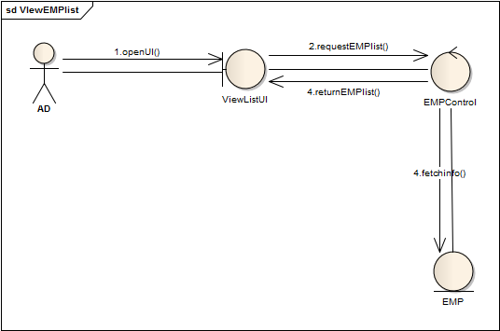
Use-case 3.3: View Employee List
Fig: Collaboration Diagram

Slide 24
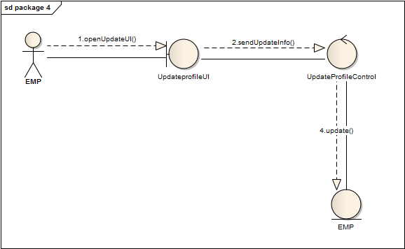
Use-case 3.4: Update Employee Profile
Fig: Collaboration Diagram

Slide 25
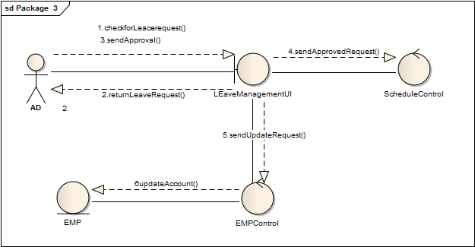
Use-case 3.5: Leave Management
Fig: Collaboration Diagram

Slide 26
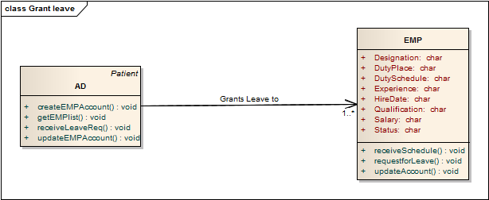
Use-case 3.5: Leave Management
Fig: Class Diagram

Slide 27
4. Scheduling System
Use-Case Glossary:
Use-case ID>Name | Description | Participant Actors and roles
4.1>Active Employee List | AD gets the active employee list | AD
4.2>Duty Schedule | AD specifies duty schedules of all employees | AD

Slide 28
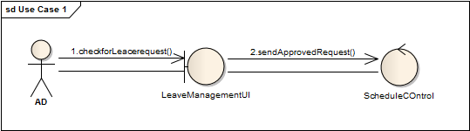
Use-case 4.1: Active Employee List
Fig: Collaboration Diagram

Slide 29
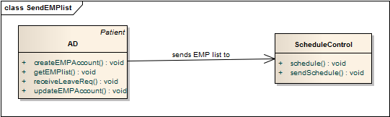
Use-case 4.1: Active Employee List
Fig: Class Diagram

Slide 30
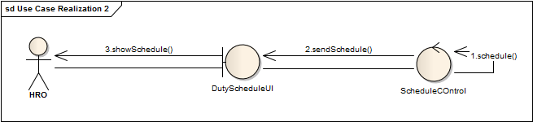
Use-case 4.2: Duty Schedule
Fig: Collaboration Diagram

Slide 31
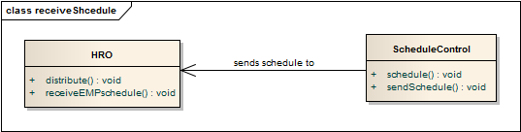
Use-case 4.2: Duty Schedule
Fig: Class Diagram

Slide 32
5. Billing System
Use-Case Glossary:
Use-case ID>Name | Description | Participant Actors and roles
5.1>Collect Bill Information | CLK collects all billing information from different sub system | CLK
5.2>Receive bill | PT gives total bill to CLK | PT,CLK
5.3> Produce Receipt | CLK produces receipt for patient | CLK

Slide 33
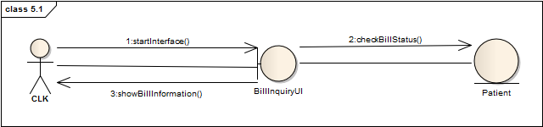
Use-case 5.1:Collect Bill Information
Fig: Collaboration Diagram

Slide 34
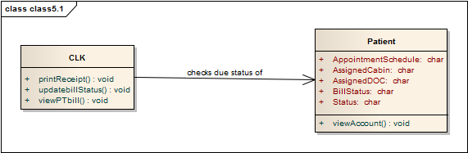
Use-case 5.1:Collect Bill Information
Fig: Class Diagram

Slide 35
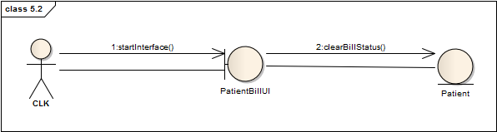
Use-case 5.2: Receive Bill
Fig: Collaboration Diagram

Slide 36
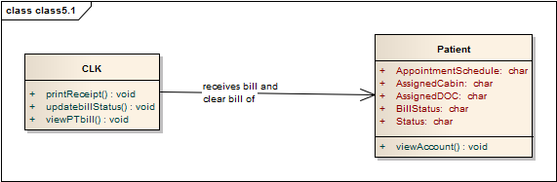
Use-case 5.2: Receive Bill
Fig: Class Diagram

Slide 37
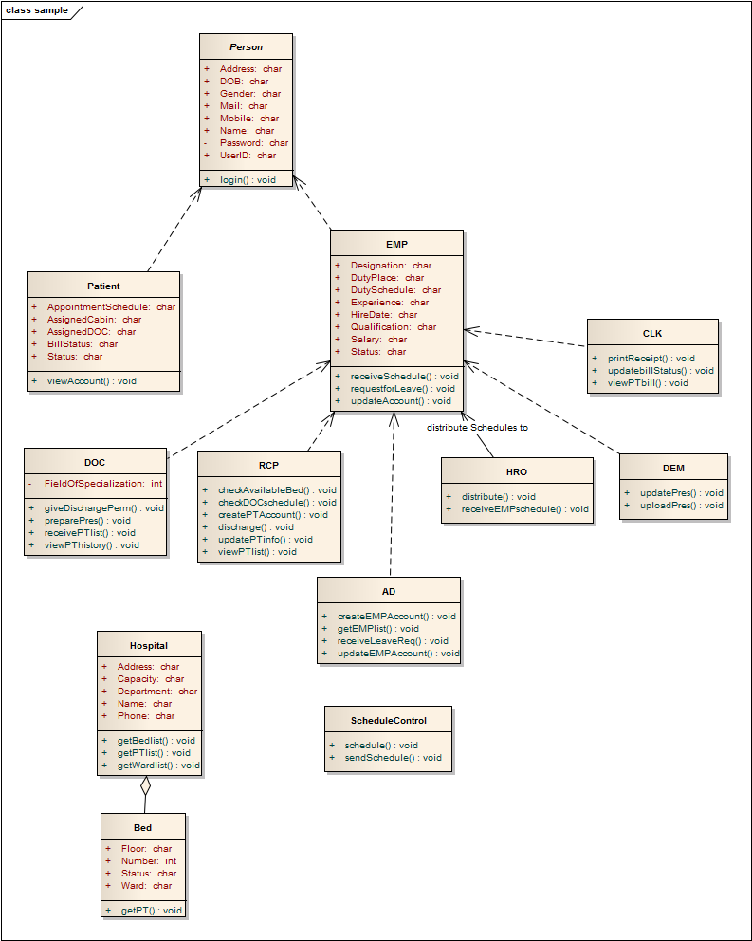
Hierarchy of Classes

Slide 38

QUESTIONS???

Slide 39
Thank You

